Slide 1
EN 410 Energy Management
Gurubalan Annadurai
guru.a@iitb.ac.in

Slide 2
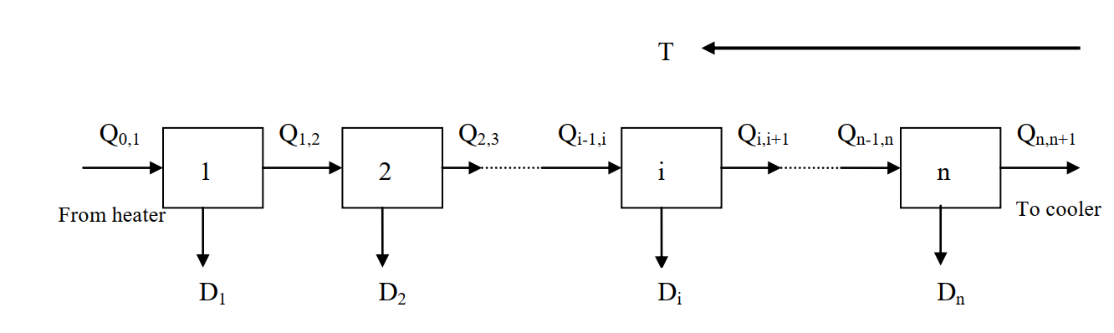
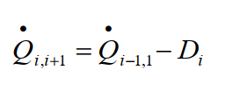
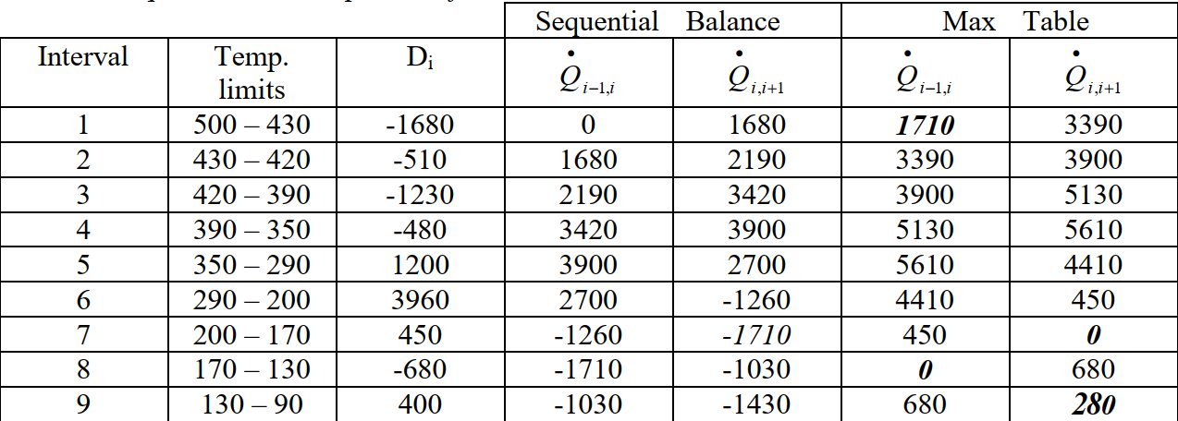
Problem table approach
5. Estimate the new supplied heat to the each interval, 1710 kW as load input in the interval 1
Pinch temperature = 170℃ (for cold= = 170℃ , hot = 180℃)
Minimum heating utility = 1710 kW
Minimum cooling utility = 280 kW

Slide 3
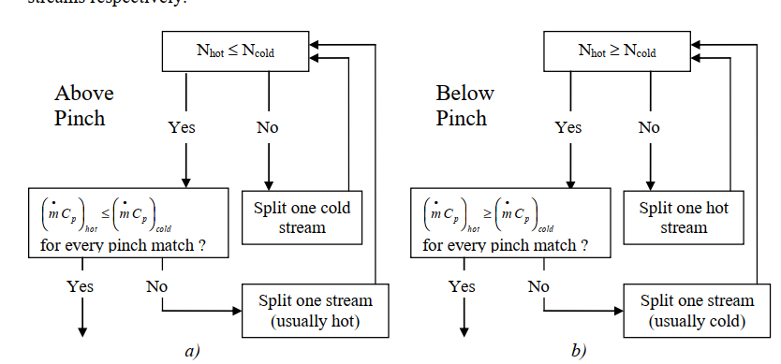
Heat exchanger network
The network above and below the pinch shall be designed separately (independently)
Start with placing a heat exchanger close to the pinch point and continue outwards
Allow the heat exchangers transfer heat as much as possible

Slide 4
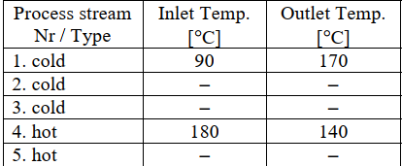
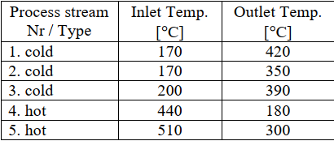
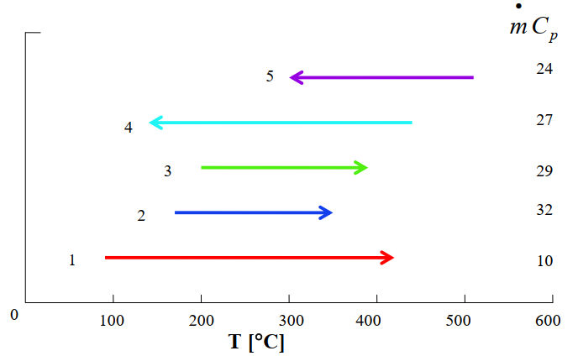
Process streams above and below pinch
 | Process stream type | Inlet temp | Outlet temp | Heat capacity rate
 | - | ℃ | ℃ | kW/K
1 | Cold | 90 | 420 | 10
2 | Cold | 170 | 350 | 32
3 | Cold | 200 | 390 | 29
4 | Hot | 440 | 140 | 27
5 | Hot | 510 | 300 | 24
1. Below Pinch
2. Above Pinch
3. Estimate ΔH

Slide 5
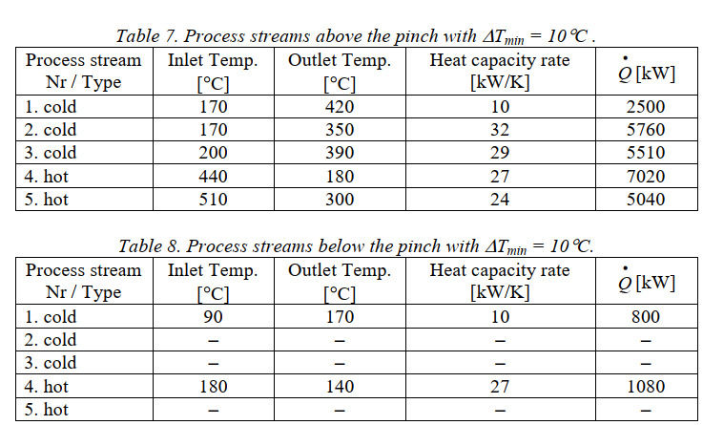
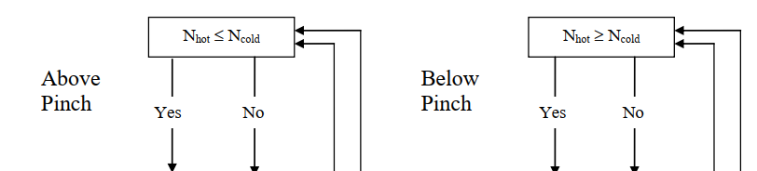
Process streams above and below pinch
3. Estimate ΔH

Slide 6
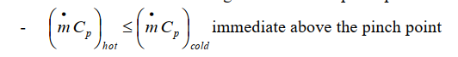
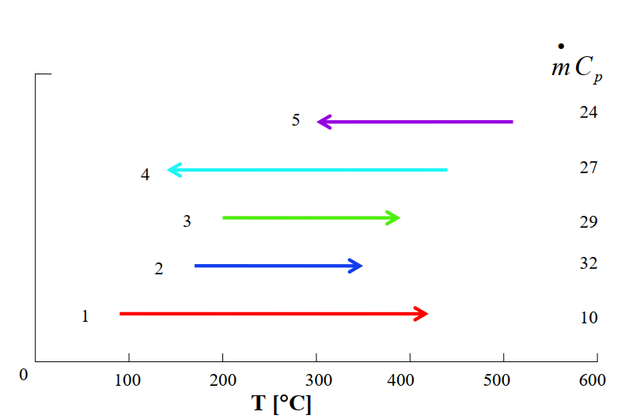
Grid diagram above pinch

Slide 7
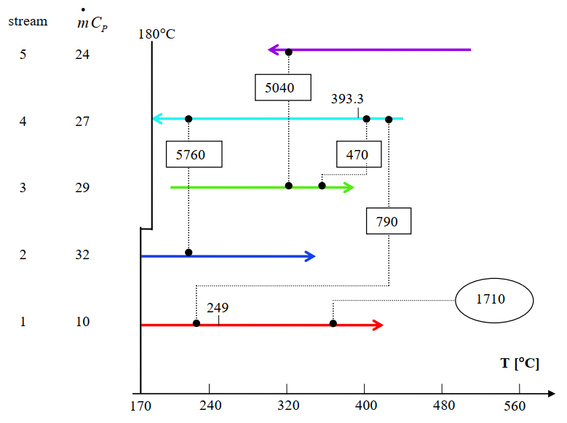
Grid diagram above pinch

Slide 8
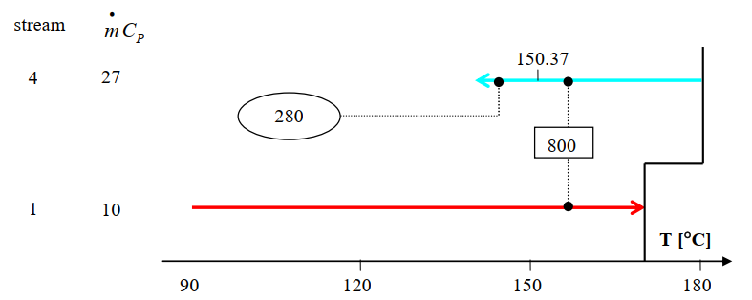
Grid diagram below pinch

Slide 9
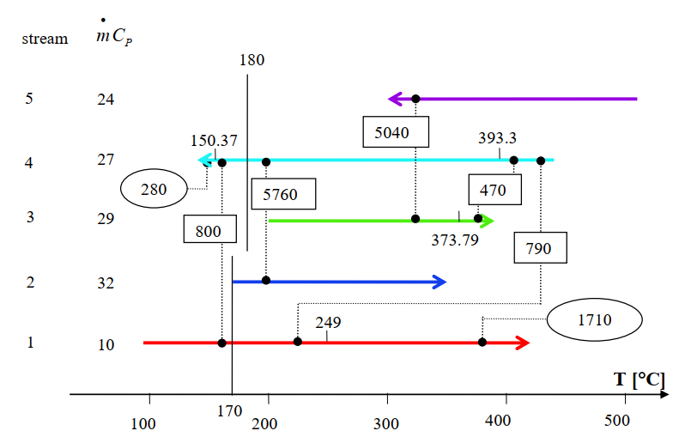
Grid diagram

Slide 10
Cogeneration
Many industries require energy input in the form of heat, called process heat. Process heat in these industries is usually supplied by steam
Industries that use large amounts of process heat also consume a large amount of electric power.
The result is a plant that produces electricity while meeting the process-heat requirements of certain industrial processes (cogeneration plant)
Cogeneration: The production of more than one useful form of energy (such as process heat and electric power) from the same energy source.

Slide 11
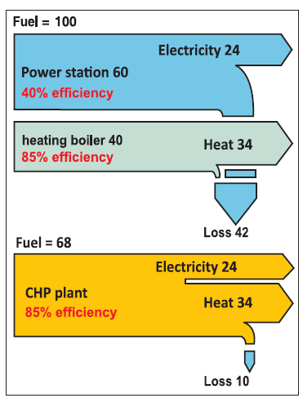
Cogeneration
Higher efficiency – lesser fuel – lesser loss – lesser pollution
A combination of power production and heating/cooling can also be used in a cogeneration scheme.
It is called trigeneration if three useful forms of energy (such as electric power, process heat, and cooling) are produced from the same energy source.

Slide 12
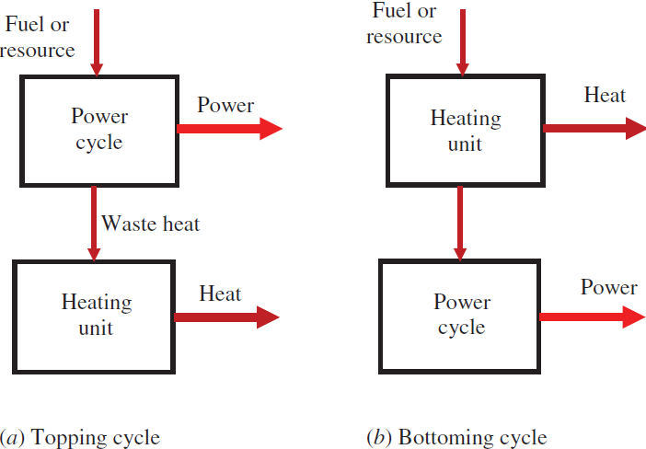
Cogeneration Schemes
Topping cycle is most commonly used. It is particularly suitable when the electric demand of the facility is greater than the thermal demand, and the process heat temperature requirements are not high.
Bottoming cyle is particularly suitable when the plant needs process heat at a high temperature. Some examples include steel reheat furnaces, clay and glass kilns and aluminum remelt furnaces.
The power cycle is also called prime mover.
Steam-turbine (Rankine) cycle, a gas-turbine (Brayton) cycle, a combined cycle (combination of Rankine and Brayton cycles), an internal combustion engine

Slide 13
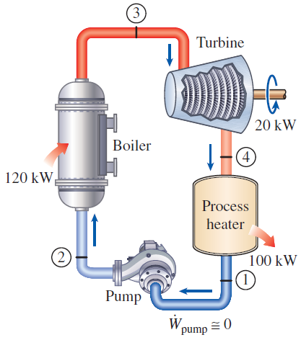
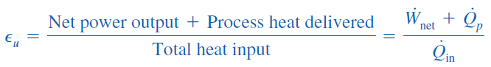
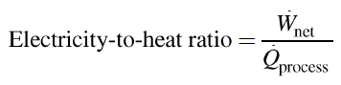
Steam-turbıne cogeneratıon
Utilization factor
Ideal since not suitable for load variation

Slide 14
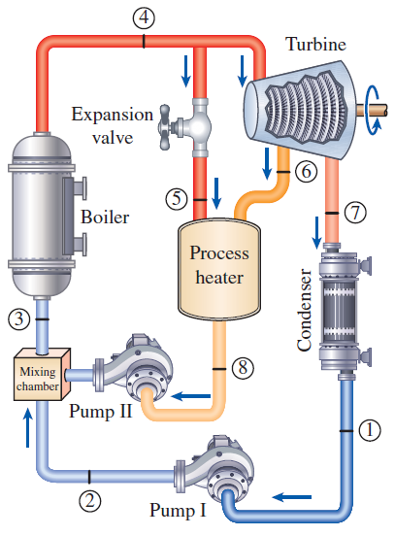
Cogeneration plant with adjustable loads
At times of high demand for process heat, all the steam is routed to the process-heating units and none to the condenser (m₇= 0). The waste heat is zero in this mode.
If this is not sufficient, some steam leaving the boiler is throttled by an expansion or pressure-reducing valve and directed to the process-heating unit.
Maximum process heating is realized when all the steam leaving the boiler passes through the valve (m₅= m₄). No power is produced in this mode.
When there is no demand for process heat, all the steam passes through the turbine and the condenser (m₅=m₆=0), and the cogeneration plant operates as an ordinary steam power plant.

Slide 15
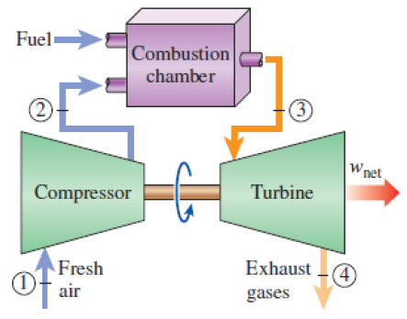
Gas-turbıne cogeneratıon
Heat is rejected to the atmosphere at a high temperature (300 to 400°C) which makes this plant very suitable for cogeneration applications.
Steam is usually taken at an intermediate stage in the turbine or from the outlet of the boiler so that the temperature is sufficiently high for process heating.
Multiple process heating at high temperature
Advantages : Simpler, easier and quicker to install and operate, and cheaper compared to steam power based cogeneration.

Slide 16
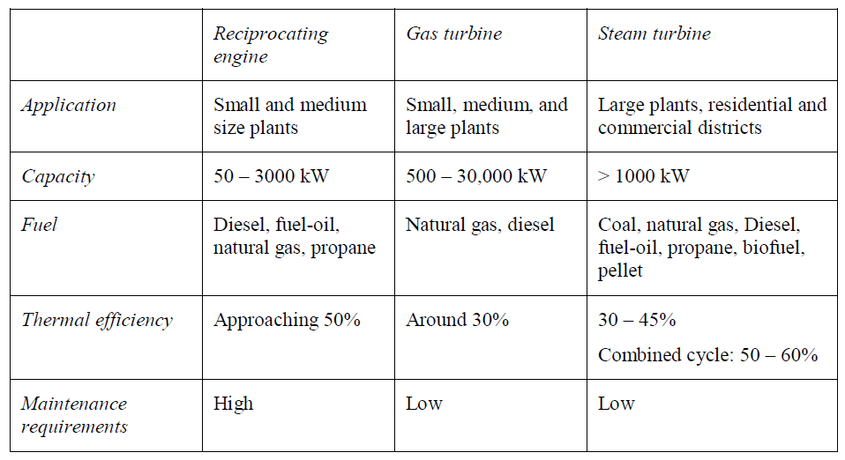
Selection of prime movers

Slide 17
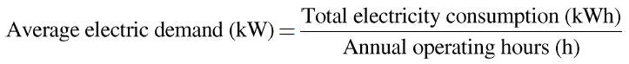
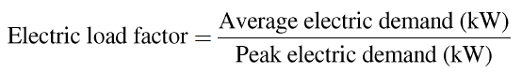
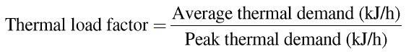
Load Factor
Electricity and heat use: A preliminary investigation of a proposed cogeneration application should start with the analysis of plant’s energy use profile. The upper and lower limits of electricity and heat use of the facility should be analyzed.

Slide 18
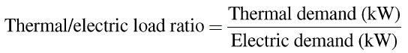
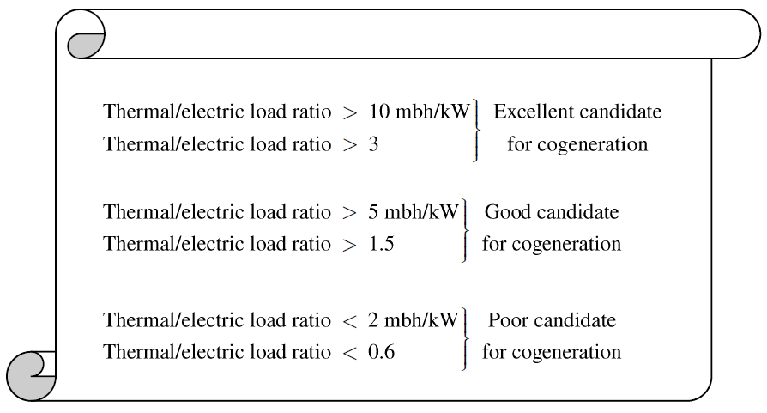
Thermal/electric load ratio
1 mbh = 1000 Btu/h
A high value of thermal/electric load ratio corresponds to a higher utilization factor for a given cogeneration system.

Slide 19
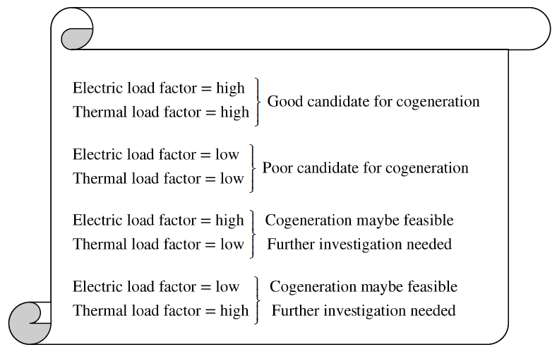
Load Factor
A high load factor is preferred for cogeneration applications as it represents the greater use of installed capacity.
A low load factor (e.g. 40%) means that if the cogeneration electricity capacity is selected based on the peak demand, the system will supply on average 40% of the installed capacity most of the time and close to full capacity for only a short period of time over a year.

Slide 20
Load Factor
If the electric load factor is high and the thermal load factor is low:
A cogeneration application can still be feasible provided that additional heat demand can be supplied from a backup boiler.
A plant may have a low thermal load factor when the boiler shuts down during a certain season (summer, no space heating)
If the electric load factor is low and the thermal load factor is high:
A cogeneration application can still be feasible provided that additional electric demand can be purchased from the utility at a reasonable price.
In this case, the voltage transformation and associated equipment cost may have to be taken care of by the plant.

Slide 21
Refences
Introduction to Pinch Technology, Rokni, Masoud, DTU
https://www.youtube.com/watch?v=MQejghnZj_w&list=PL_UhBh-E8IOLmkctKJng1EmQru3RDZyV7&index=8

